Slide 1
Editor background and grid
Advanced Graphics Programming

Slide 2
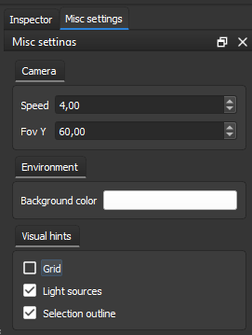
Overview
Two visual hints of the editor
Procedural gradient-based background
Horizon line perception
Procedural grid
Improved perception of distances
Method
Two separated post-processing shaders
Screen-filling quad
Camera parameters

Slide 3
Grid

Slide 4
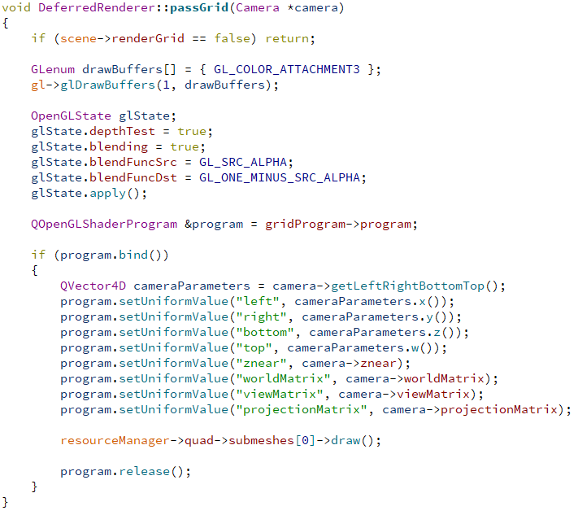
Grid pass in the renderer class

Slide 5
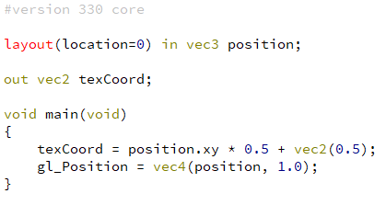
Grid vertex shader
Input:
Screen-filling quad is rendered
Bottom-left corner (-1, -1, 0)
Top-right corner (1, 1, 0)
Output:
We forward texCoords in range [0, 1] to the fragment shader

Slide 6
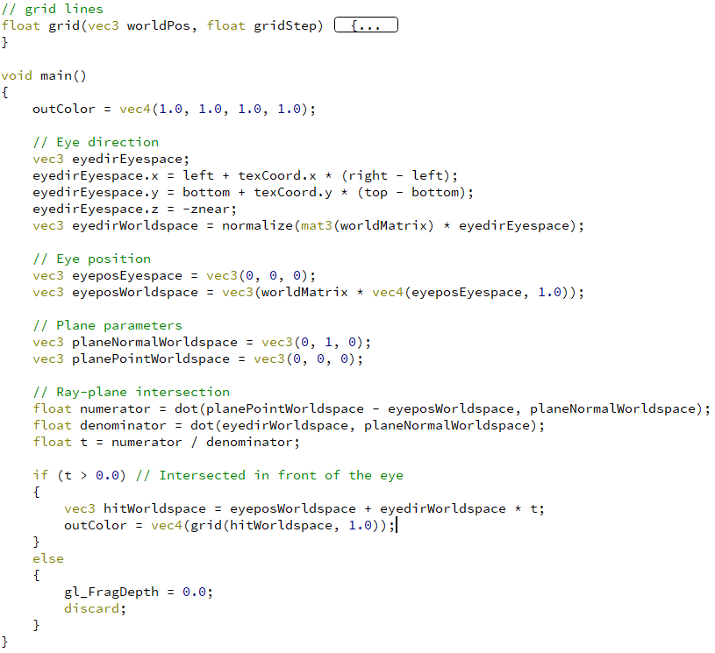
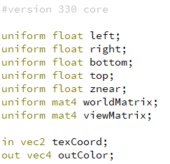
Grid fragment shader
Inputs:

Slide 7

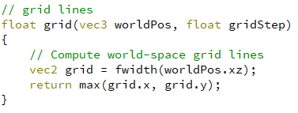
Grid fragment shader

Slide 8
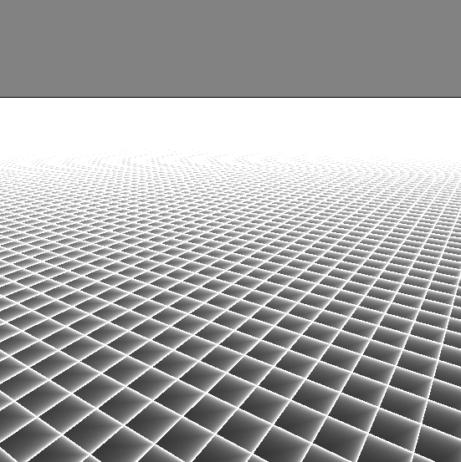
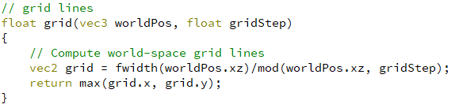
Grid fragment shader

Slide 9
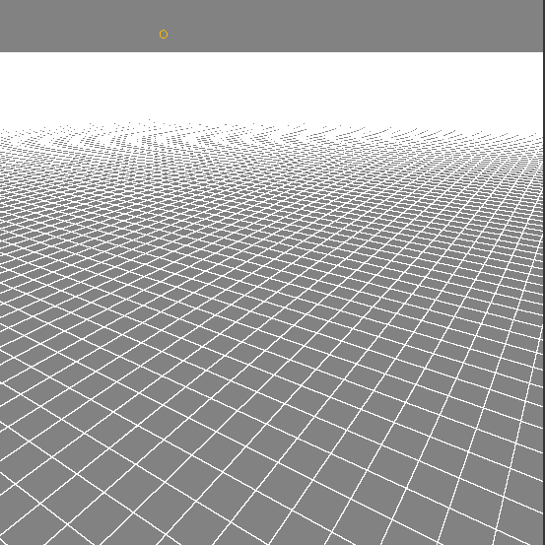
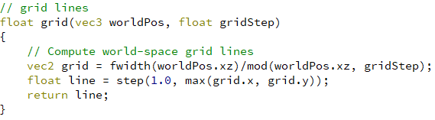
Grid fragment shader

Slide 10
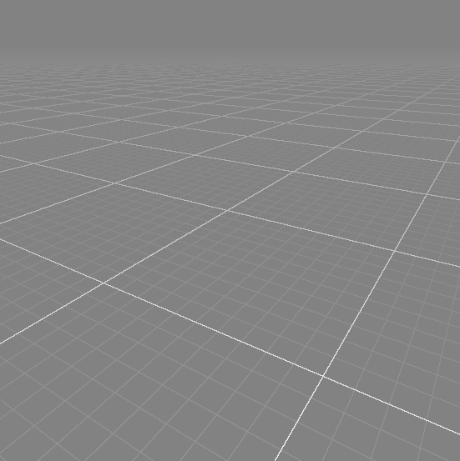
Grid fragment shader
And now?
Use several calls to grid() with different grid steps.
1.0
10.0
100.0
Decide alpha based on distances and grid steps.

Slide 11
Background

Slide 12
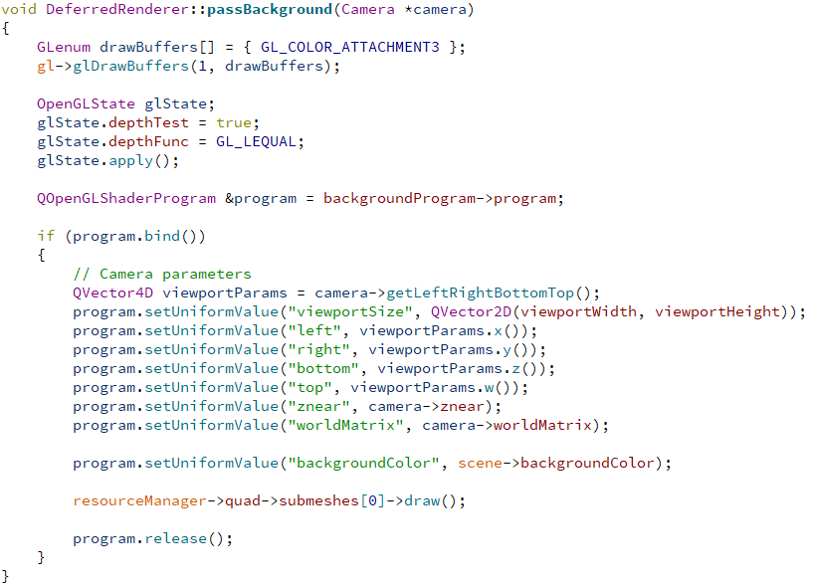
Background pass in the renderer class

Slide 13
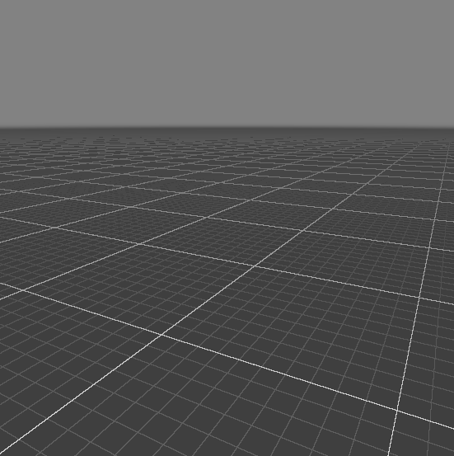
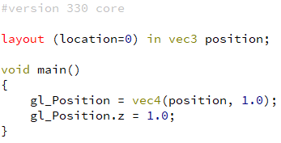
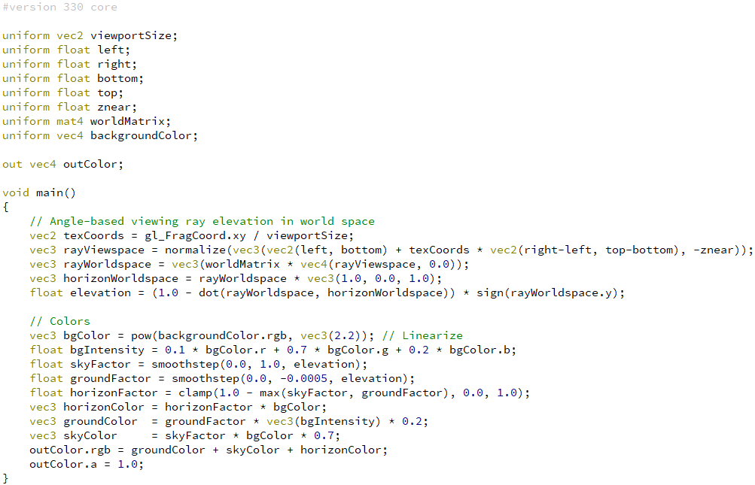
Background shaders
Vertex shader
Fragment shader

Slide 14

Questions?

